Slide 1
Welding

Slide 2
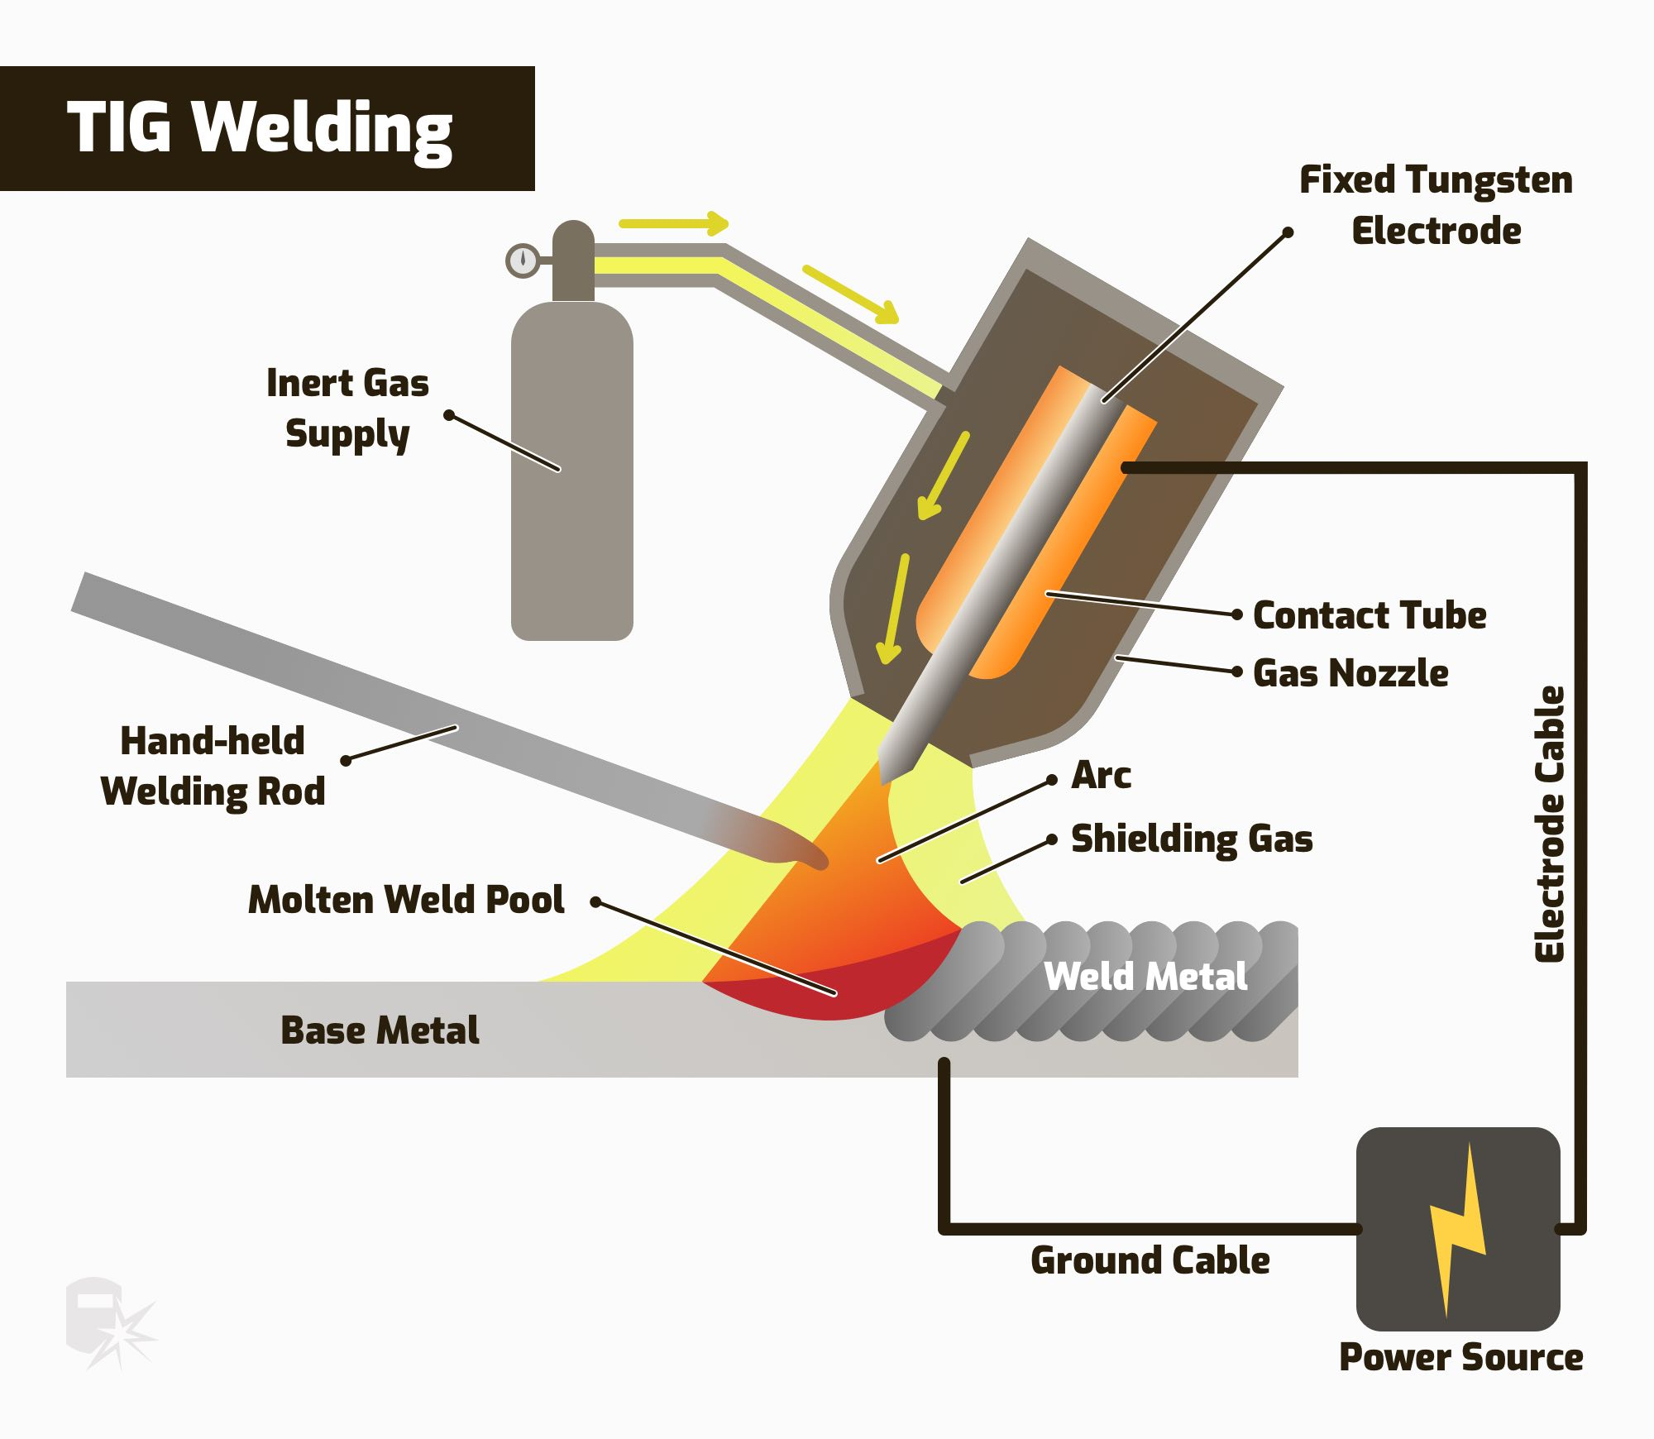
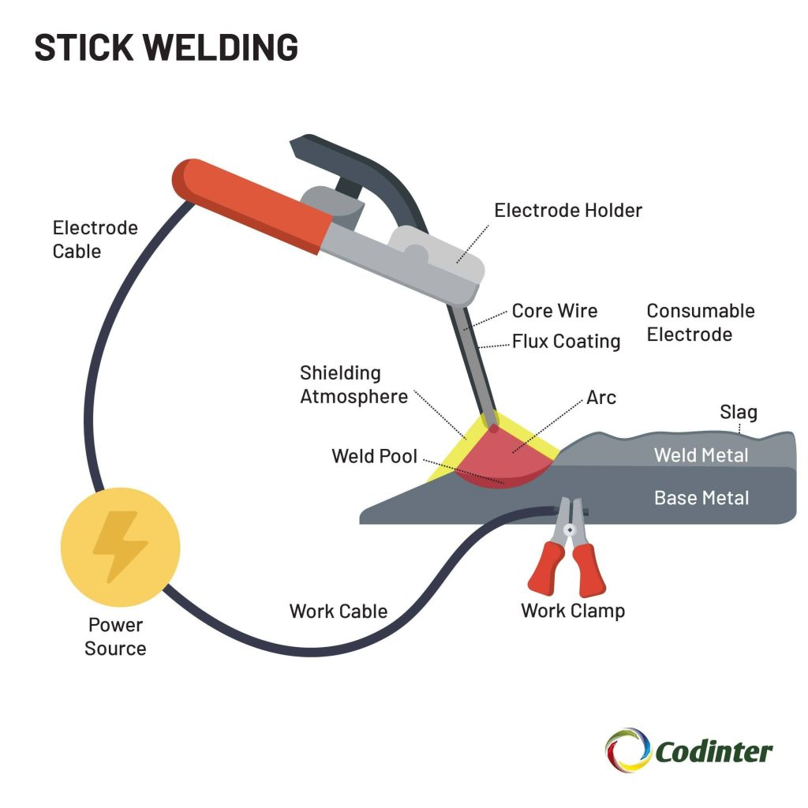
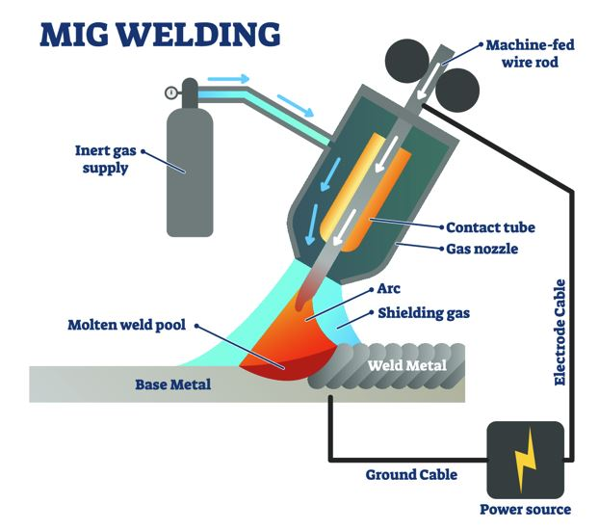

Slide 3
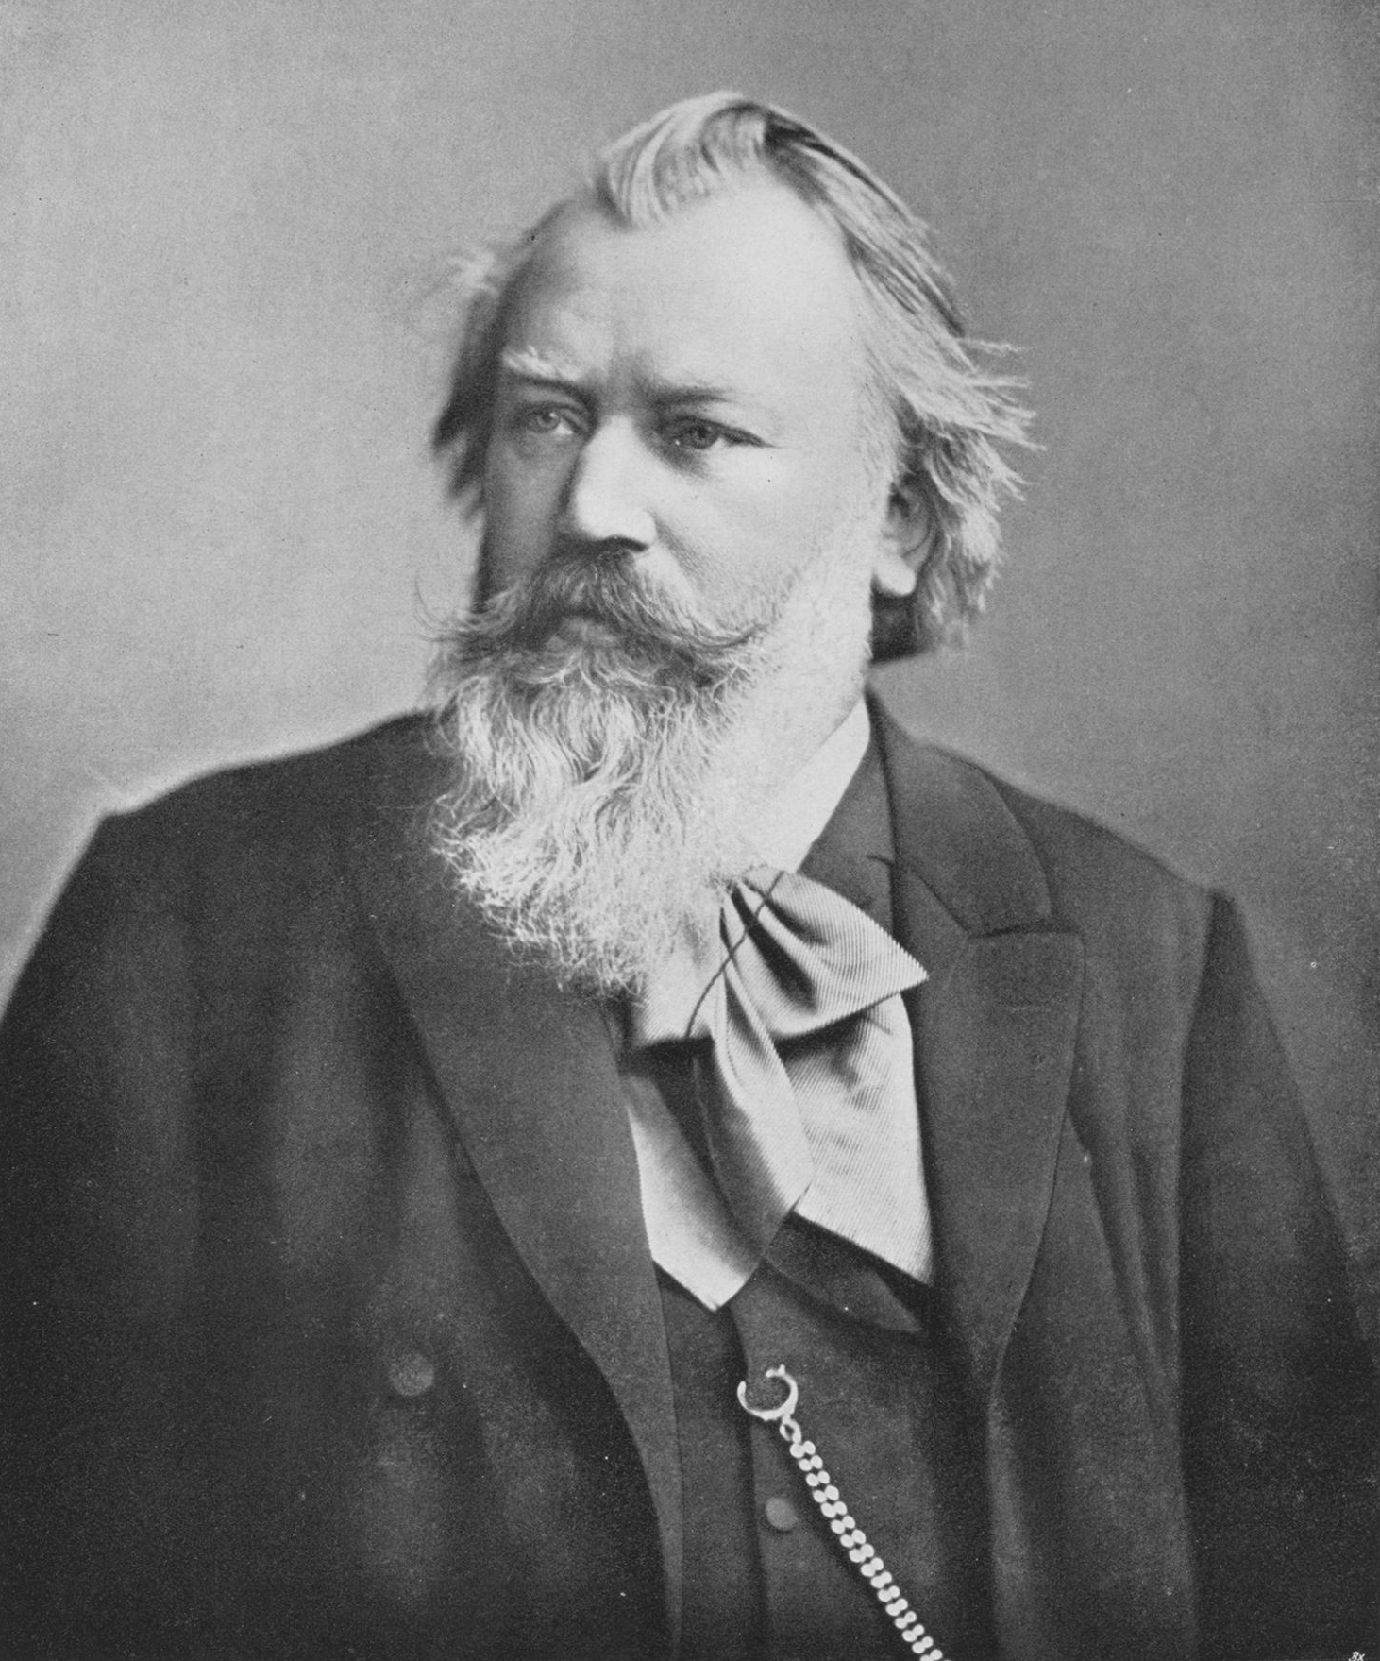
HMS (HSE)

Slide 4
Fire safety
All must have read the hot work instructions
Must know where the fire extinguishers are
Must know that welding creates immense heat and nearby items might ignite

Slide 5
Other HSE
Use extractor fan, keep it close. Otherwise you will inhale heavy metals
Use the correct gloves for the correct task
  Precision -> thinner gloves
  Heat management -> thicker gloves
The electrode can shock you (if you manipulate the torch with it on) and will get warm during use

Slide 6
Setup

Slide 7
TIDY THE BENCH
Please

Slide 8
Equipment setup
Sharpen electrodes
Connect the machine and check settings
The clamp goes beneath the table
Get the correct fill metal (Aluminium vs steel, thickness)
Clean your workpiece (grind off and use potentially use IPA)
Secure material to bench as necessary
Turn on the exhaust fan
Close the curtains and switch to “opptatt” (occupied)

Slide 9
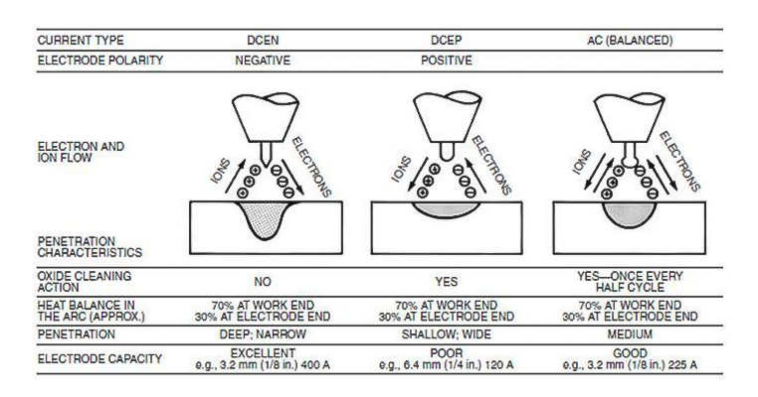
Polarity

Slide 10
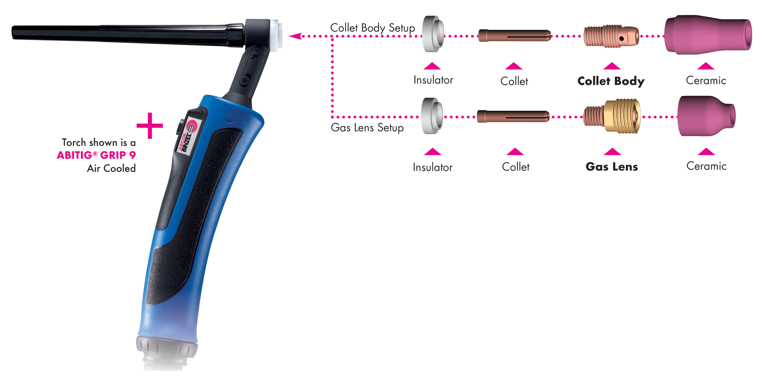

Slide 11
The mask
Two types, fixed-shade and automatics
We only use automatics
Adjust so you can see well, without discomfort

Slide 12
Covering up
The light from the arc can do more than blind you
Always cover your skin, or you will have massively increased risk of skin cancer
Coverall works well, especially use if your clothes contain plastic

Slide 13
Technique

Slide 14
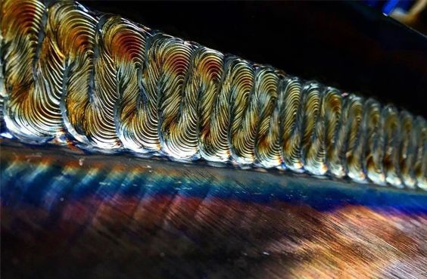
Is sex-appeal the goal?

Slide 15
No, we want strength

Slide 16
How to achieve appropriate penetration
Sharp electrode
Correct settings
Correct distance
Correct angle
Correct movements

Slide 17
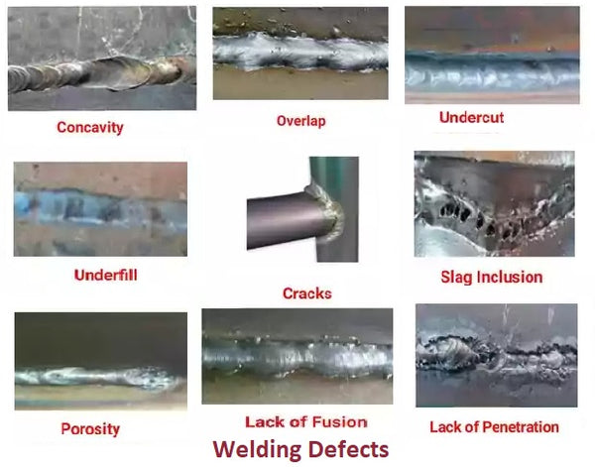
What makes for a good weld?

Slide 18
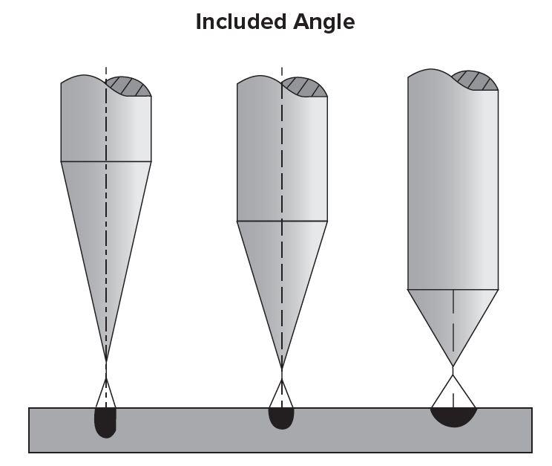
Sharp electrodes
The angle determines the penetration
Sharper is wanted, to a point. 50-60 degrees works well

Slide 19
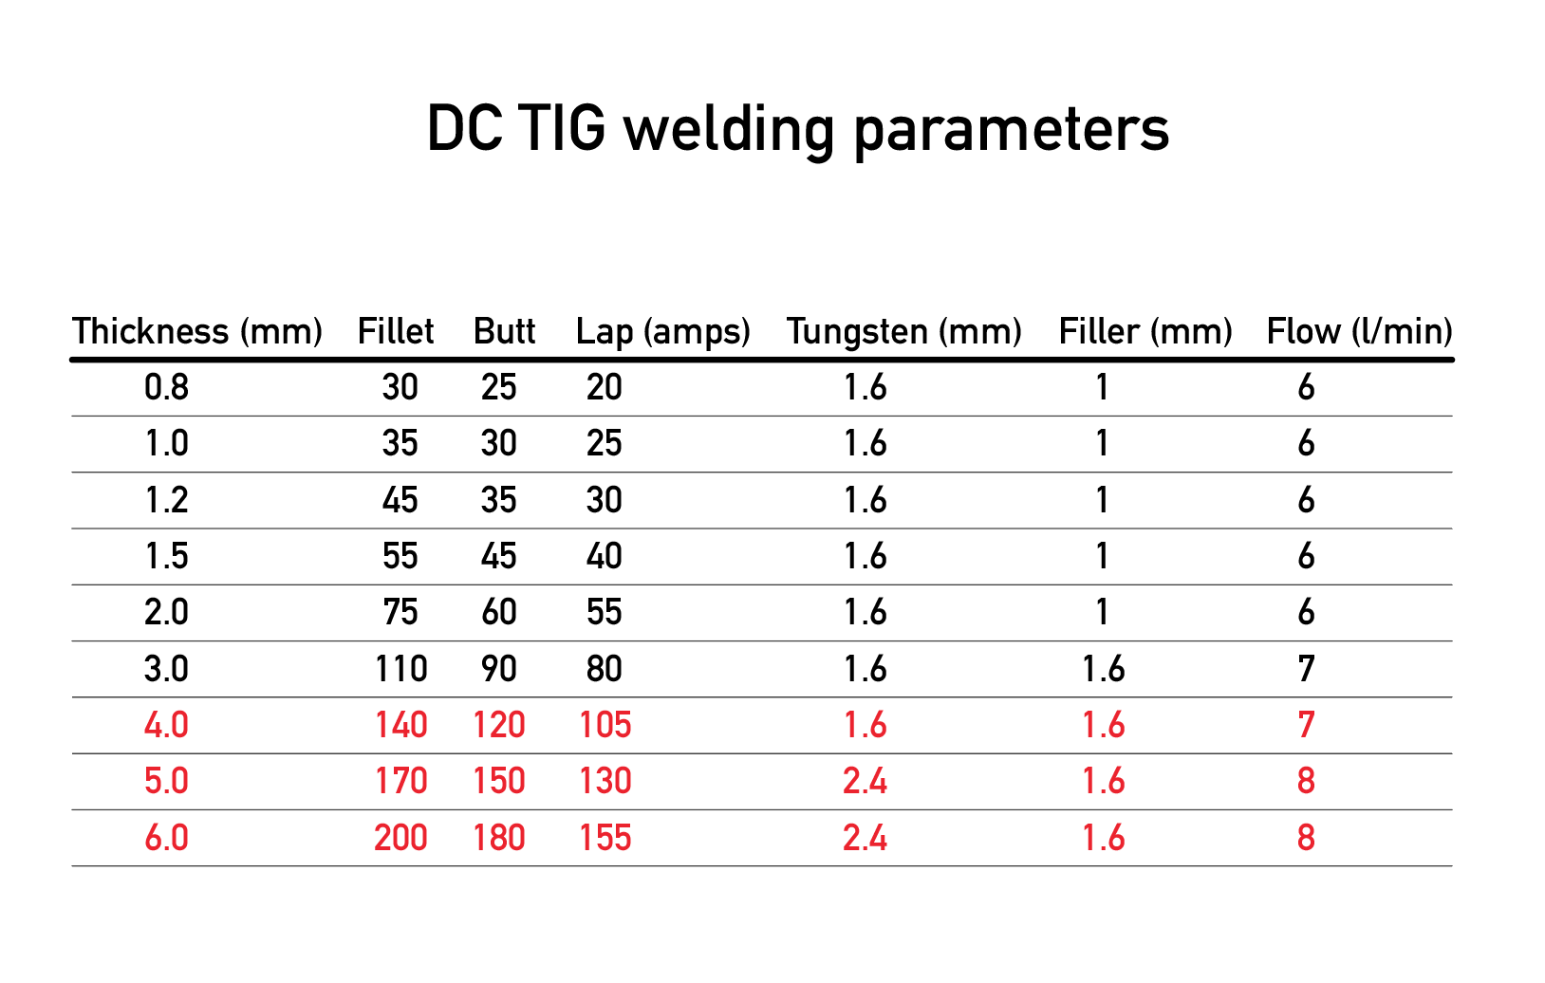
Correct settings
A balance between amps (heat) and movement speed

Slide 20
Pre- and postflow
Preflow is for cleaner starts
Postflow is to stop inclusions when instantly shutting off gas
No need to overdo it, we do not need to waste gas.
Pre: 1-2 seconds
Post: 4-7 seconds

Slide 21
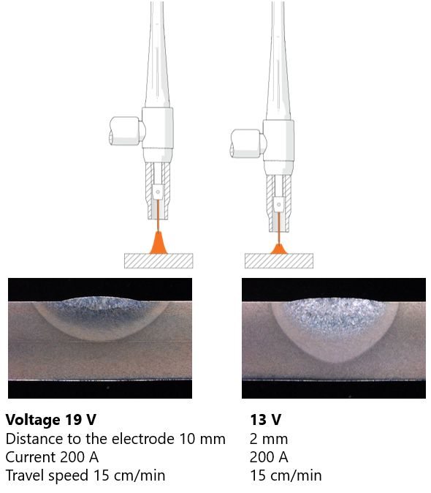
Correct distance
Too far away – shallow penetration
Too close – might touch and cake/stuck the electrode
Balance is needed – 1 to 5 millimeters is a good range
Look at the arc, if it is wide or moves erratically, move closer

Slide 22
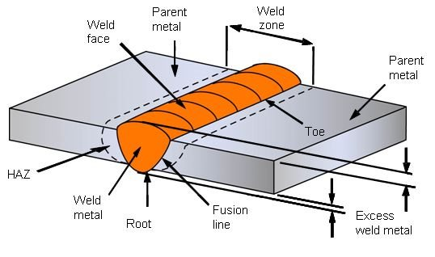
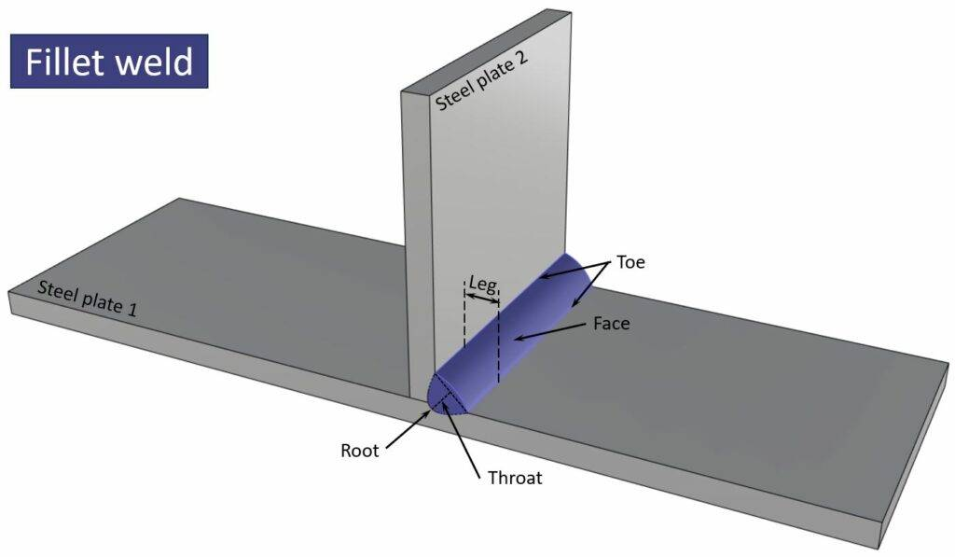
Correct angle and movements
This is the hard part
Experience teaches well
But some base rules are good:
  Simple lines work for simple work (butts, maybe laps)
  For better welds and more complex work, use a zig-zag motion or similar
In the end it all boils down to…

Slide 23
The puddle
Read it, learn it and make it your friend

Slide 24
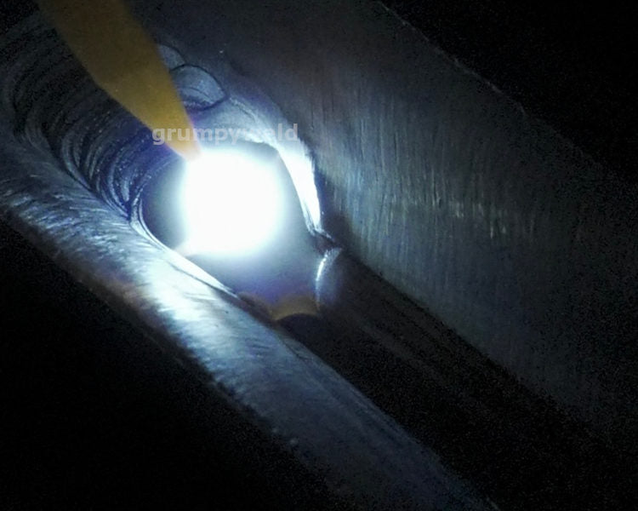

Slide 25
Welding well means loving the puddle
Never leave your puddle, it is your weld
  The puddle follows the heat, so the tip of your electrode
Puddle too small, fill more
Puddle too big, move more or check distance
Puddle sinking, move more or reduce heat
Keep watch of the puddle’s consistency
  If it becomes matt, it is not hot enough
  Bad puddle consistency -> bad welds

Slide 26
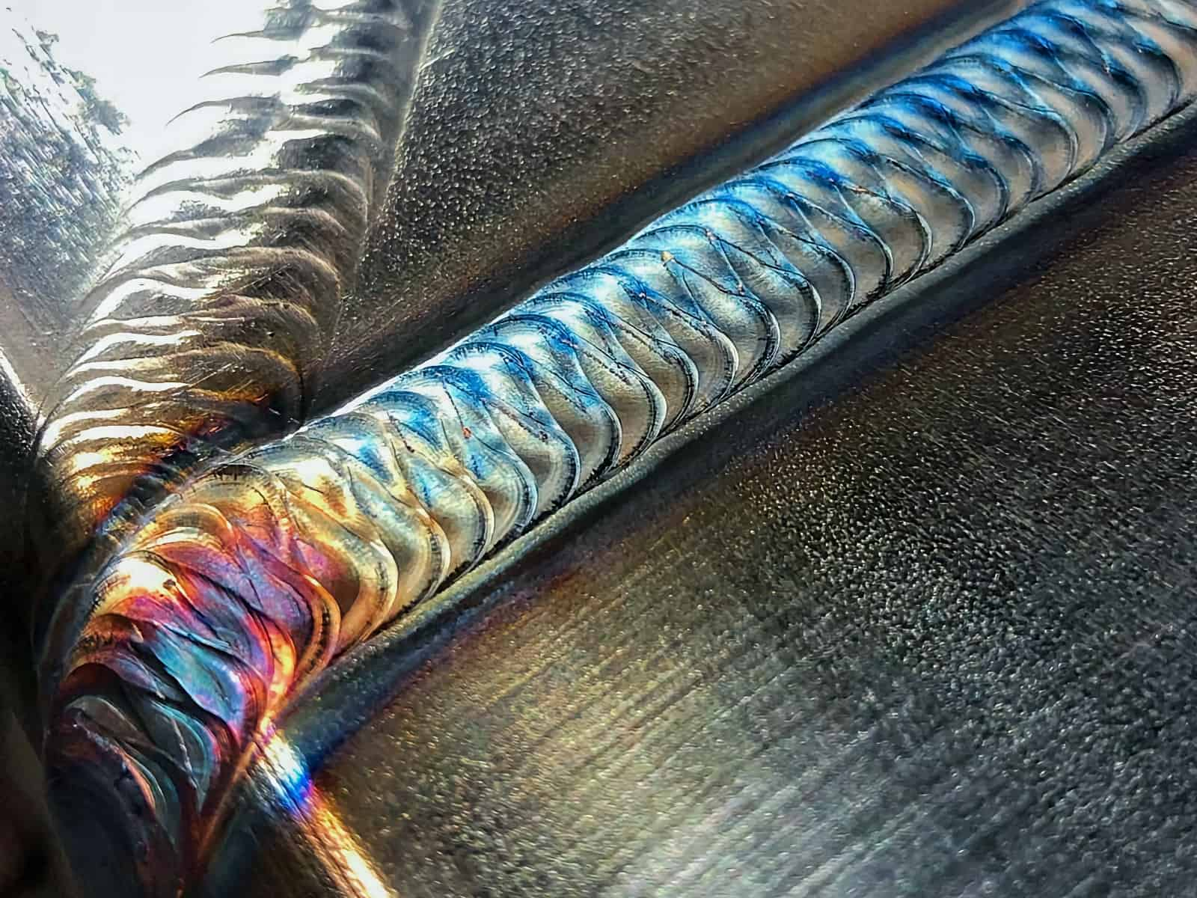
Do you see how the puddle has moved?

Slide 27
Further potential learning
Ignore if only running basics

Slide 28

Aluminium welding
Hard, more to think about than steel or even stainless
AC needed (DCEP possible, but discouraged due to electrode eating tendencies)
  This is due to the oxidization of aluminium
  We need to remove the oxide before welding
  Current pulls the oxide off

Slide 29
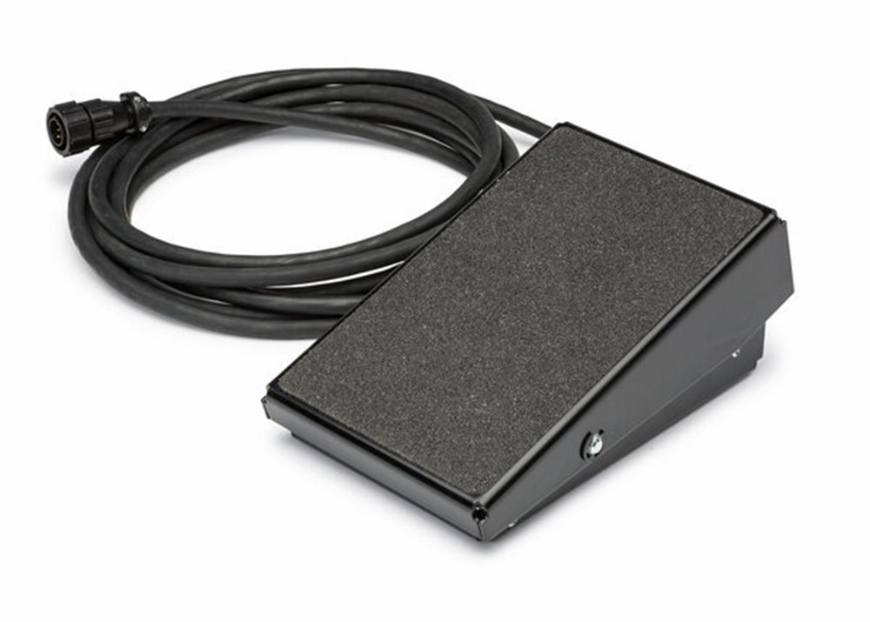
Pedal welding
For precise heat control throughout a weld

Slide 30
When you’re done welding
Turn off the machine
Turn off the gas
Let the workpiece cool down (stay at the workshop a minimum of 1 hour and check)
TIDY UP AFTER YOURSELF

